Slide 1
Relationship Designators in RDA: Connecting the Dots
100 1# Schiff, Adam L., $e author.
245 10 Relationship designators in RDA : $b connecting the dots / $c Adam L.
Schiff, Principal Cataloger, University of Washington Libraries.
500 ## Presentation given at Oregon Library Association Annual Conference,
April 16, 2015, Hilton Eugene & Conference Center, Eugene, Oregon.
710 2# Oregon Library Association. $b Annual Conference $d (2015 : $c
Eugene, Or.), $e sponsoring body.
Adam L. Schiff
Principal Cataloger
University of Washington Libraries

Slide 2
A good deal of RDA is devoted to relationships: chapters 17-37
Relationship designators are defined in 18.1.6, 23.1.5, 24.1.5, and 29.1.5
Allow you to be more specific about the relationship than what the MARC tags alone can provide.
Notes:
Since the initial release of RDA, Chapter 23 has been a placeholder for instructions on the subject relationship that would be developed later. With the April 2015 update to RDA, you will now find some general instructions about recording subject relationships, including using relationship designators.

Slide 3
Relationship Designators in RDA
A designator (i.e., a term/phrase) that indicates the nature of the relationship between entities represented by authorized access points, identifiers, and/or descriptions. Four main types of relationships:
Between works, expressions, manifestations, and items and persons, families, and corporate bodies – FRBR Group 1 - Group 2 relationships (RDA 18.1.6, 18.4.1, 18.5, Appendix I)
Between works and what the works are about (subject relationships) – FRBR Group 1 - Group 3 relationships (RDA 23.1.5, 23.5, Appendix M)
Between works, expressions, manifestations, and items – FRBR Group 1 - Group 1 relationships (RDA 24.1.5, 24.4, 24.5, Appendix J )
Between persons, families, and corporate bodies – FRBR Group 2 - Group 2 relationships (RDA 29.1.5, 29.4, 29.5, Appendix K)
Notes:
FRBR Group 1 entities are work, expression, manifestation, and item (WEMI). They represent the products of intellectual or artistic endeavor.
FRBR Group 2 entities are person, family and corporate body, responsible for the custodianship of Group 1’s intellectual or artistic endeavor.
FRBR Group 3 entities are subjects of Group 1 or Group 2’s intellectual endeavor, and include concepts, objects, events, places.
Chapter 23 and Appendix M dealing with subject relationships and relationship designators for subjects are new with the April 2015 update to RDA.

Slide 4
Relationship Designators in RDA
Relationship designators are not core in RDA, but PCC has developed best practice guidelines for bibs and authorities, and has made their use mandatory in some cases
Although developed for RDA, you may use relationship designators in non-RDA records. “Hybrid record” guidelines are available from PCC at http://www.loc.gov/aba/pcc/rda/PCC%20RDA%20guidelines/Post-RDA-Implementation-Guidelines.html: “Feel free to add approved RDA relationship designators to any access points.”
Notes:
PCC “hybrid record” guidelines tell catalogers to “Feel free to add approved RDA relationship designators to any access points.” The language in each of the guidelines is a little different but the intent is the same.
PCC Guidelines for Enhancing & Editing non-RDA Monograph Records: Feel free to add approved RDA relationship designators to any access points. Do not remove any existing $e, $j, or $4 subfields. Feel free to add $e, $j, or $4 as long as the term/code comes from a controlled vocabulary (RDA, MARC, etc.).
PCC Guidelines for Enhancing & Editing non-RDA Serial Records: Feel free to add approved RDA relationship designators to any access points if desired. Do not remove any existing $e, $j, or $4 subfields. Feel free to add $e $j, or $4 as long as the term/code comes from a controlled vocabulary (RDA,MARC, etc.).
Guidelines for Creating a Hybrid Record from a pre-RDA Record (Integrating resources): Feel free to add approved RDA relationship designators to any access points if desired.

Slide 5
MARC Coding
Appendix I designators
Use $e in 100, 110, 700, 710; use $j in 111 and 711
Put $e and $j after the access point
Copy designators exactly as found in RDA Appendix I, including parentheticals such as (expression) and (item)
700 1# Bacharach, Burt, $e composer (expression)
700 1# Voinquel, Raymond, $d 1912- $e dedicatee (item)
Precede first $e/$j with a comma unless the access point ends with a hyphen
110 2# Northwest Mapping Service, $e cartographer.
111 2# International Smelting Technology Symposium $d (2012 : $c Orlando, Fla.), $j author.
700 1# Wang, Shijie $c (Metallurgist), $e editor.
100 1# Alexander, Elizabeth, $d 1962- $e author.
Separate multiple $e’s with a comma
100 1# Miller, Frank, $d 1957- $e author, $e artist.
700 1# Chaplin, Charlie, $d 1889-1977, $e film director, $e screenwriter, $e actor.
710 1# New Zealand. $b Department of Conservation, $e issuing body, $e publisher.
Field ends with a period unless final designator ends in parenthetical

Slide 6
MARC Coding
Appendix J designators
Use $i in 700/710/711/730 access points for works and expressions, and in 76X-78X linking fields
Not used in 8XX (no $i); not used yet in 780/785 per CONSER Cataloging Manual
Put $i at beginning of field, capitalize the first letter of the first word, and follow it with a colon
Copy designators exactly as found in RDA Appendix J, including parentheticals such as (work) and (expression)
700 1# $i Motion picture adaptation of (work): $a Alcott, Louisa May, $d 1832-1888. $t Little women.
775 08 $i Reproduction of (manifestation): $t Fair Em. $d London : M.E. Sims & Co., 1895 $w (OCoLC)17007035
Don’t forget to input correct subfields after the designator!
700 12 $i Container of (expression): $a James, E. L. $t Fifty shades of Grey. $l Spanish.
775 08 $i Reproduction of (manifestation): $t Fair Em. $d London : M.E. Sims & Co., 1895 $w (OCoLC)17007035
Notes:
CONSER Cataloging Manual
14.1.3: Although $i relationship information is defined for MARC 21 Bibliographic 780 and 785 fields, CONSER participants do not include $i relationship designators in these fields at this time.
14.1.6: Linking entry fields (other than 780 and 785) can generate relationship designators using display text in $i instead of the display constant when the field indicators are “08” (“generate a note, no display constant generated”). … Relationship designators generated from linking entry fields with display text in subfield $i can be used in lieu of 530 and 580 fields in many instances. The PCC Policy Committee’s Relationship Designators in Bibliographic Records guideline 14 states: “If a cataloger wishes to indicate a known relationship to a known resource, and the $i relationship information subfield is defined for the MARC 7XX field being used, provide a relationship designator.” CONSER participants prefer use of this technique whenever possible.

Slide 7
PCC Guidelines on Relationship Designators in Bib Records
Three documents to know:
PCC Guidelines for the Application of Relationship Designators in Bibliographic Records
http://www.loc.gov/aba/pcc/rda/PCC%20RDA%20guidelines/Relat-Desig-Guidelines.docx
Training Manual for Applying Relationship Designators in Bibliographic Records
http://www.loc.gov/aba/pcc/sct/documents/rel-desig-guide-bib.pdf
PCC Guidelines for the Application of Relationship Designators in Authority Records
http://www.loc.gov/aba/pcc/rda/PCC%20RDA%20guidelines/Relat-Desig-Guidelines-AUTH-Final.docx
Notes:
The third set of guidelines on authority records is still in a draft form. In this session we are only going to talk about bibliographic records.

Slide 8
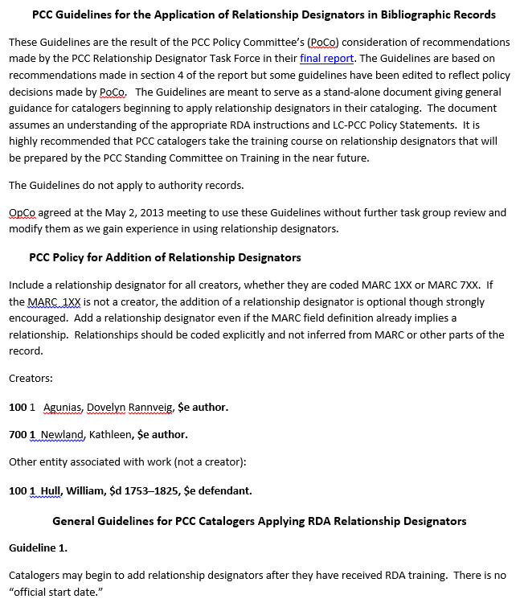
Notes:
Screen shot of the first page of the PCC Guidelines for the Application of Relationship Designators in Bibliographic Records. This serves as a stand-alone document giving general guidance for catalogers beginning to apply relationship designators in their cataloging. The Guidelines assume an understanding of the appropriate RDA instructions and LC-PCC Policy Statements as well as the MARC 21 Bibliographic Format.

Slide 9
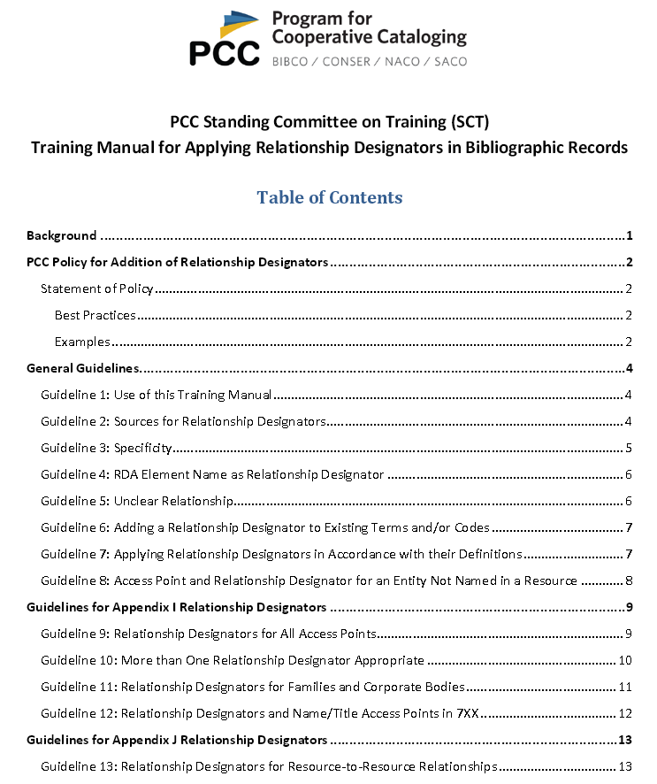
Notes:
The Training Manual is intended to provide additional guidance in applying the Guidelines, by giving additional examples to illustrate each of the guidelines.

Slide 10
PCC Guidelines on Relationship Designators in Bib Records
Include a relationship designator for all creators (whether 1XX or 7XX)
100 1_ Bassett, Carol Ann, $e author.
If the 1XX is not a creator (e.g., a defendant), including relationship designator is optional but strongly encouraged
Add designator even if the MARC field definition already implies a relationship (e.g., 700 12; 776). Code relationships explicitly rather than infer them from MARC.
700 12 $i Container of (work): $a Elgar, Edward, $d 1857-1934. $t Variations on an original theme.
776 08 $i Print version: $a Belknap, George N. (George Nicholas), 1905-1996. $t University of Oregon charter. $d Eugene, Oregon : University of Oregon, 1976 $w (OCoLC)3162104
Notes:
Key points of the PCC Guidelines on Relationship Designators
The second indicator value of 2 in 7XX implies an analytical added entry, that is, that a resource includes whatever is referenced in the field. The 776 field is defined as additional physical form linking entry. In both cases, the PCC guidelines tell us to use a relationship designator even though the MARC field already implies a relationship.
Note: “Print version” and “Online version” are not in RDA, but they are allowed by PCC.

Slide 11
PCC Guidelines on Relationship Designators in Bib Records
Highly encouraged to include Appendix I relationship designators for all access points whenever it is clear what the relationship is
Prefer terms from RDA appendices; propose new terms when needed; however, terms from other lists may also be used (e.g., MARC relator terms, RBMS relationship designators, etc.)
Do not use MARC relator codes ($4) in addition to relationship designators/relator terms. But ok to leave existing $4’s in a record if they are correct and add relator terms. Add them before the codes (i.e., put $e’s or $j’s in front of $4’s)
Notes:
PCC participants may use a web form to propose new relationship designators. Non-PCC libraries may send proposals directly to the ALA representative to the Joint Steering Committee for Development of RDA.

Slide 12
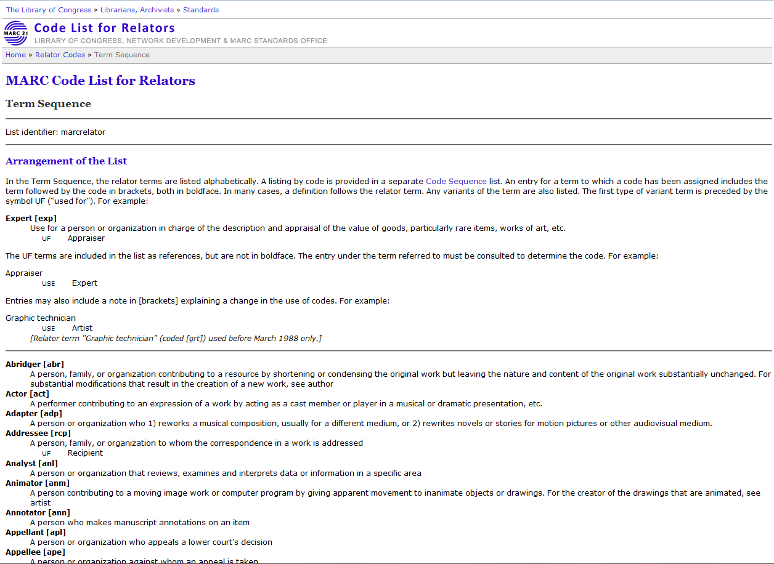
Notes:
Screenshot from the MARC Code List for Relators. There are numerous terms on this list that are not in RDA. There are also different terms for the same role, e.g. “cinematographer” on the MARC relator term list is “director of photography” in RDA Appendix I. Prefer RDA relationship designators over MARC relator terms.
If a relationship designator is not found in RDA, you may use terms found on other lists, such as this one.

Slide 13
PCC Guidelines on Relationship Designators in Bib Records
Prefer a specific term to a more general one (e.g., use librettist instead of author for the creator of a libretto)
Notes:
Key points of the PCC Guidelines on Relationship Designators

Slide 14
PCC Guidelines on Relationship Designators in Bib Records
May use RDA element name as a relationship designator if nothing else more specific expresses the relationship, e.g.
creator
contributor
publisher
distributor
manufacturer
Notes:
Key points of the PCC Guidelines on Relationship Designators

Slide 15
PCC Guidelines on Relationship Designators in Bib Records
If nature of relationship cannot be ascertained even at a general level, don’t use a designator
Be careful to apply designators according to their definitions and the FRBR level they fit under, e.g.
artist (work level designator for a creator)
vs.
illustrator (expression level designator for a contributor)
Notes:
Key points of the PCC Guidelines on Relationship Designators

Slide 16
PCC Guidelines on Relationship Designators in Bib Records
Preferably, use repeatable $e (or $j in 111/711) when entity has multiple roles; add the designators in WEMI order
100 1_ Sendak, Maurice, $e author, $e illustrator.
700 1_ Allen, Woody, $d 1935- $e screenwriter, $e film director, $e actor, $e composer (expression)
Note: no comma used after the access point when $e follows a hyphen
Notes:
Key points of the PCC Guidelines on Relationship Designators

Slide 17
PCC Guidelines on Relationship Designators in Bib Records
If necessary, multiple fields with same access point may be used instead
100 1_ Roethke, Theodore, $d 1908-1963, $e author.
700 1_ Roethke, Theodore, $d 1908-1963, $e former owner. $5 WaU
Relationship of author applicable universally; relationship of former owner only applicable to an item owned by UW Libraries
Notes:
Key points of the PCC Guidelines on Relationship Designators

Slide 18
PCC Guidelines on Relationship Designators in Bib Records
Do not include Appendix I designators in name/title access points tagged MARC 700-711 or 800-811, or in a name/title linking field tagged MARC 76X-78X
700 02 $i Container of (work): $a Aristotle. $t Metaphysics.
700 02 $i Container of (work): $a Aristotle, $e author. $t Metaphysics
not
Notes:
Key points of the PCC Guidelines on Relationship Designators

Slide 19
PCC Guidelines on Relationship Designators in Bib Records
Use of relationship designators from Appendix J for resource-to-resource relationships is encouraged
700 1_ $i Sequel to: $a Rowling, J. K. $t Harry Potter and the Chamber of Secrets.
700 1_ $i Motion picture adaptation of (work): $a O'Hara, Mary. $t My friend Flicka.
730 0_ $i Supplement to (work): $a Lexicon of Greek personal names.
LC-PCC PS for J.1: Give $i as first subfield, capitalize the first word in the designator, and end the subfield with a colon.
Notes:
Key points of the PCC Guidelines on Relationship Designators
When MARC subfield $i for a relationship designator is used in a bibliographic record, give it as the first subfield, capitalize the first word in the designator, and end the subfield with a colon.

Slide 20
PCC Guidelines on Relationship Designators in Bib Records
If MARC 7XX field being used has the subfield $i defined, provide a relationship designator even if the MARC field coding otherwise already expresses a relationship
700 12 $i Container of (work): $a Brahms, Johannes, $d 1833-1897. $t Sonatas, $m clarinet, piano, $n op. 120.
700 12 $i Container of (expression): $a Vaughan Williams, Ralph, $d 1872-1958. $t Studies in English folk song; $o arranged.
700 12 $i Container of (work): $a Milhaud, Darius, $d 1892-1974. $t Duo concertant.
Notes:
Key points of the PCC Guidelines on Relationship Designators

Slide 21
Which direction?
Definitions in Appendix J describe the entity that the designator points to, not what the bibliographic record is describing in 245, 264, 300, etc.
100 1_ McCarthy, Cormac, $d 1933- $e screenwriter.
245 14 The counselor : $b a screenplay / $c Cormac McCarthy.
730 0_ $i Screenplay for motion picture (work): $a Counselor (Motion picture : 2013)
Definition: A work [Counselor (Motion picture : 2013)] that uses the text [McCarthy’s script The counselor] as a screenplay for a motion picture.
Notes:
The relationship designator definitions should be applied to the related work/expression/manifestation/item, not the resource that is being described in the main part of the bibliographic record (the 245, 264, 300, etc.).

Slide 22
Many designators changed in April 2014
In the April 2014 update to RDA, numerous changes were made to existing designators, and many new ones were added. Be sure to check the current lists in RDA Appendixes I-K. Correct obsolete relationship designators found in copy.
Change examples:
editor of compilation → editor
contains (work) → container of (work)
continues (work) → continuation of (work)
supersedes (work) → replacement of (work)
adapted as a motion picture (work) → adapted as motion picture (work)

Slide 23
Any obsolete designators? Any errors to correct?
Notes:
First record: The relationship designator “contains (work)” was changed in April 2014 to “container of (work)”. All of the designators in this record should be updated. In addition, there are also errors in the third, fourth, and sixth designators: these are access points for expressions, not works. The relationship designators for these access points should be corrected to “Container of (expression)”
Second record: “editor of compilation” is obsolete and should be changed to “editor”. The punctuation is also incorrect: in the first 700 there shouldn’t be a comma after the open-ended date, and in the second 700 the period should be a comma.
Third record: In the second 700 the periods between the designators should be commas. In the third and fourth 700s there should not be commas after the date. In the fifth 700, the first word of the designator should be capitalized and there should be a colon at the end of it.

Slide 24
Exercises
You have been given printouts of OCLC records and lists of relationship designators from RDA Appendices I and J. Relationship designators have been removed from the OCLC records.
The next slide shows a few MARC relator terms that are not in RDA.
For each access point in the OCLC records (1XX, 7XX) determine which, if any, relationship designators or relator terms, should be added to them.
Note which MARC coding and punctuation you would use with each designator.

Slide 25
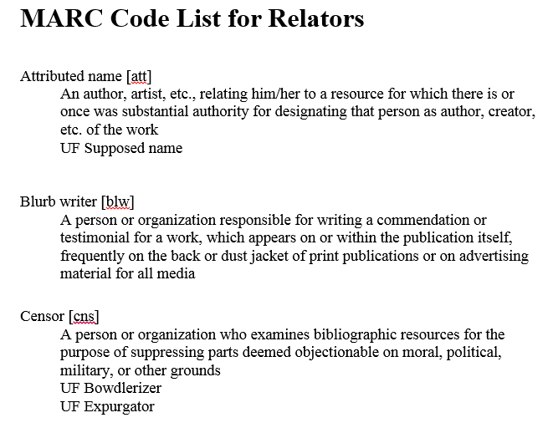
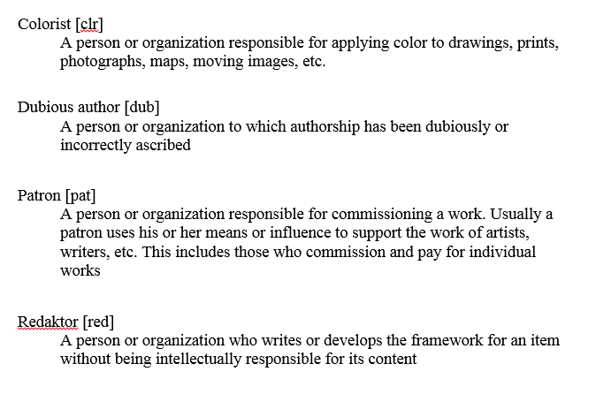
Notes:
Some sample terms found in the MARC Code List for Relator that may be useful for the exercises.

